Slide 1
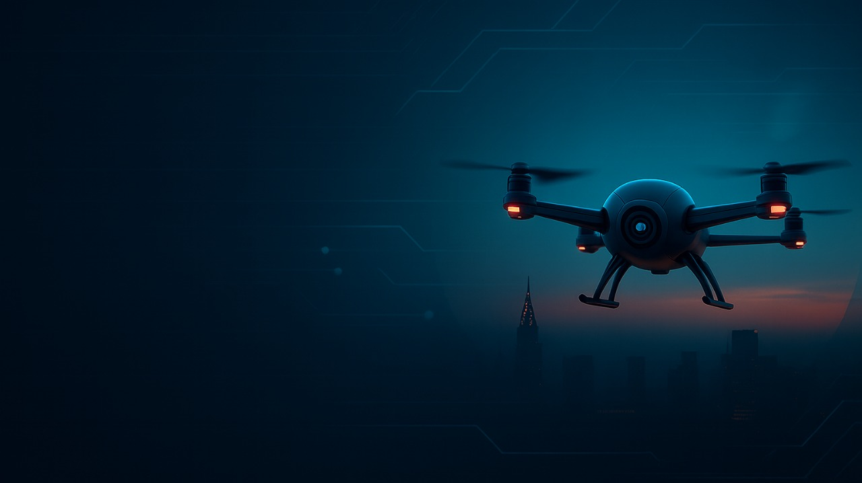


Title: Emergency Safety & Health Response Drone System
MAILAM
Engineering College

Slide 2


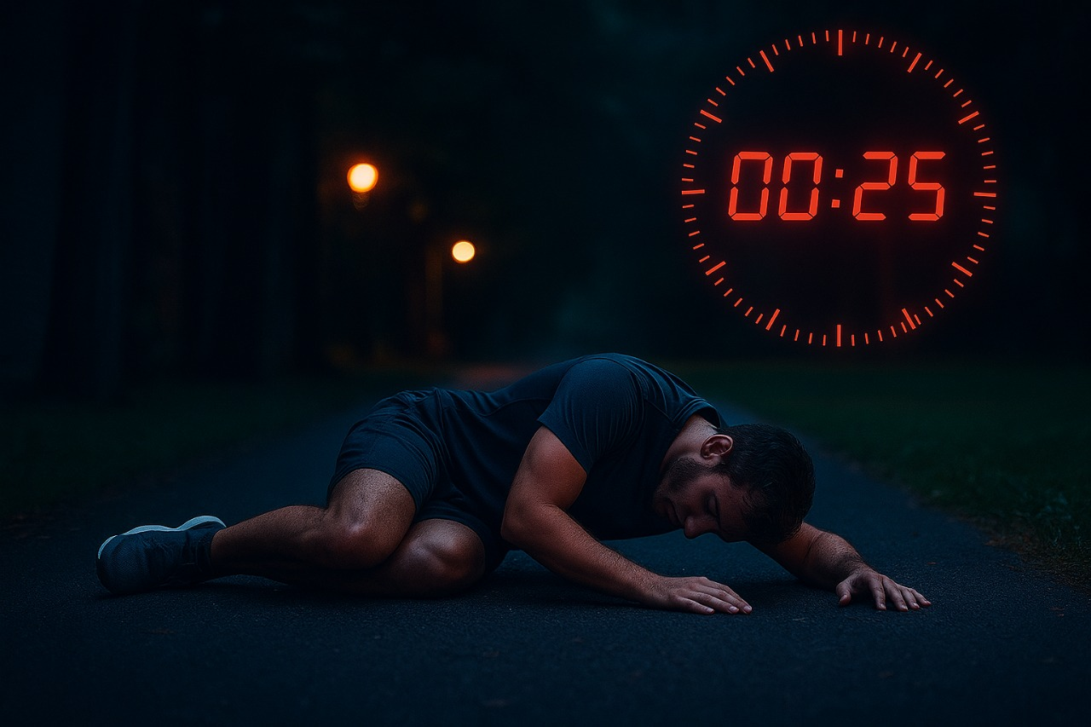
The Challenge: Delays in Safety & Emergency Response
👩‍🦰Women's Safety Risks
❤️‍🩹Medical Emergencies in Public
Harassment, stalking, and violence in public areas..
Collapses or unconscious people often go unnoticed.

Slide 3
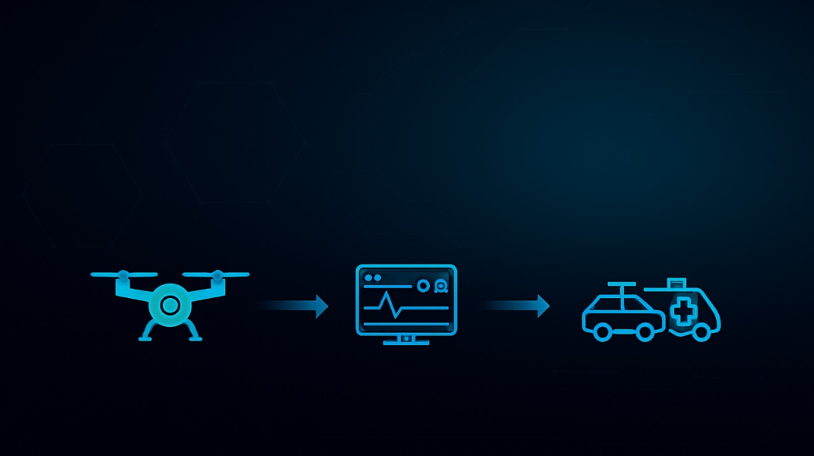
Our Solution: AI Safety & Emergency Drone System
Drones patrol allocated zones on continuous rounds.
AI detects unusual or threatening activities and medical emergencies.
System streams live video, audio, and GPS to the control room.
Police/ambulance are dispatched instantly with precise location.
Drone
Control Room
Police/Ambulance

Slide 4
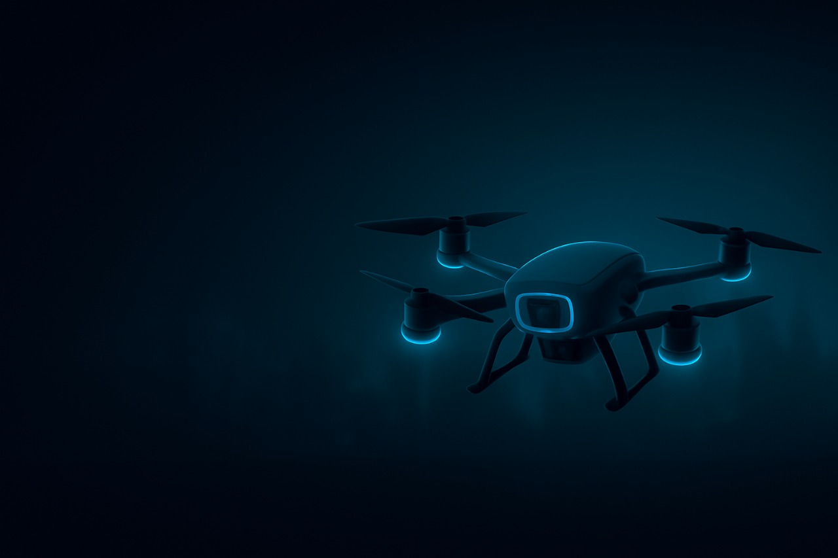

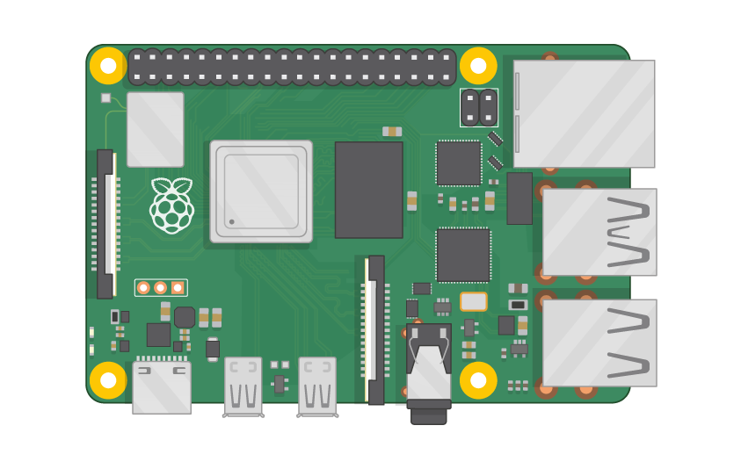
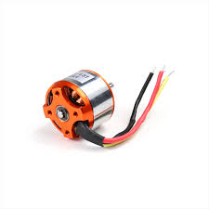
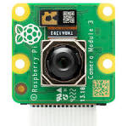
Hardware Overview :
Onboard Computer (Raspberry Pi / AI Chip)
Runs Python, AI models, and drone control logic.
Camera Module Captures live video & images for AI analysis.
GPS Module Provides real-time location tracking.
4G LTE / Wi-Fi Module Enables live communication with router & police dashboard.
Drone Frame, Motors, ESC, Battery Core quadcopter system for stable flight & long patrols.

Slide 5

Software Stack & Technologies
Python → Main language for drone control, AI vision,
and backend integration.
OpenCV → Handles video processing for motion, object, and activity detection.
YOLO /
TensorFlow → Lightweight AI models on Raspberry Lite Pi for real-time threat detection.
Flask / Fast API → Backend APIs enabling communication between app, drone, and dashboard.
React.js → Police control room interface for live video, alerts, and monitoring.
(Web Dashboard)

Slide 6

System Architecture: How It Works
4G / Wi-Fi
Drone Hardware
Drone frame, camera,
GPS, sensors collect data.
Onboard Computer
(Raspberry Pi / AI Chip)
Detects threats, emergencies, and anomalies in real time.
Backend (Flask / Fast API)
APIs connect drones, apps, and web dashboard.
User Interfaces
Police Dashboard (React.js) → Live monitoring & alerts.

Slide 7
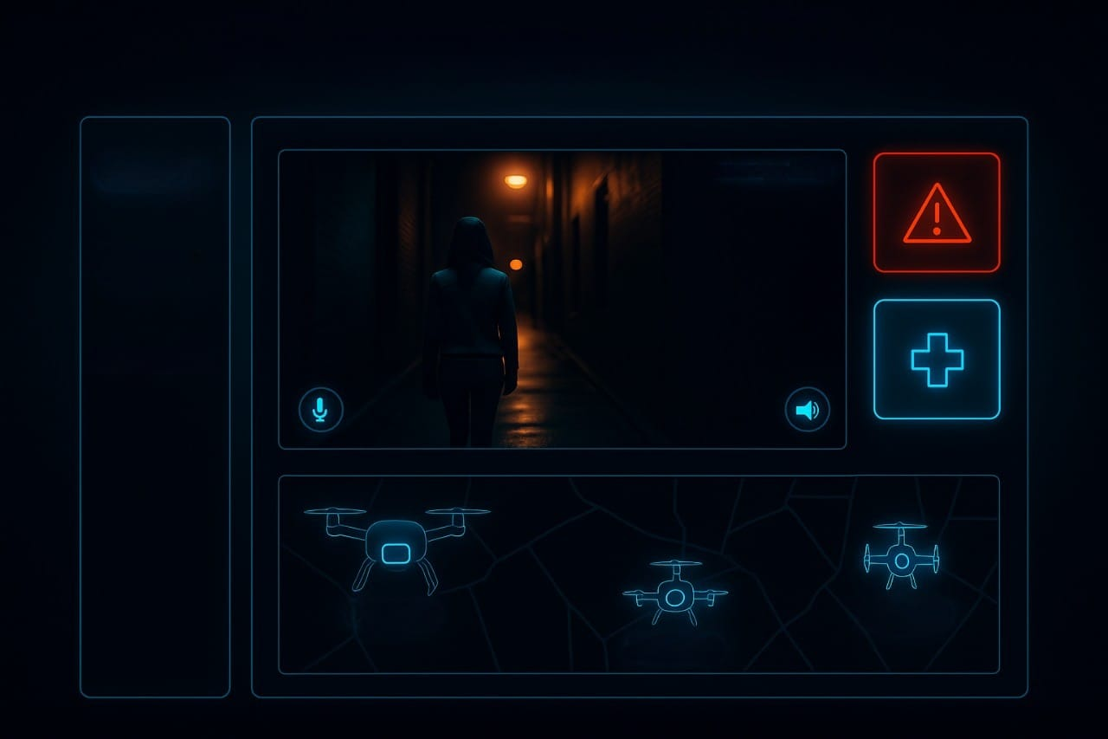

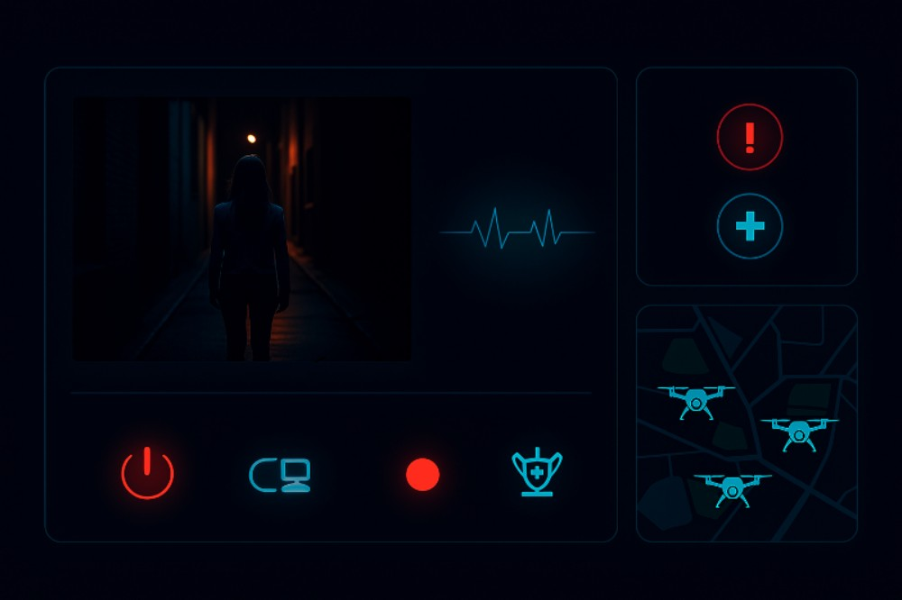
Dashboard & Control Room
Drone-1
41.4083 2.1744
Drone-2
Drone-3
Drone-1
Drone-2
Drone-3

Slide 8
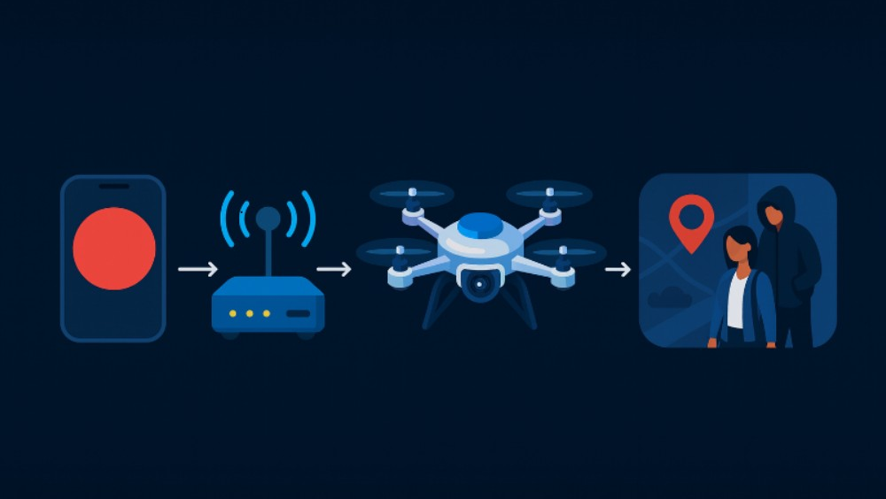
Flowchart of Working
SOS
Sos Signal
Drone Router
AI-Powered Drone
Dedication of Incident

Slide 9

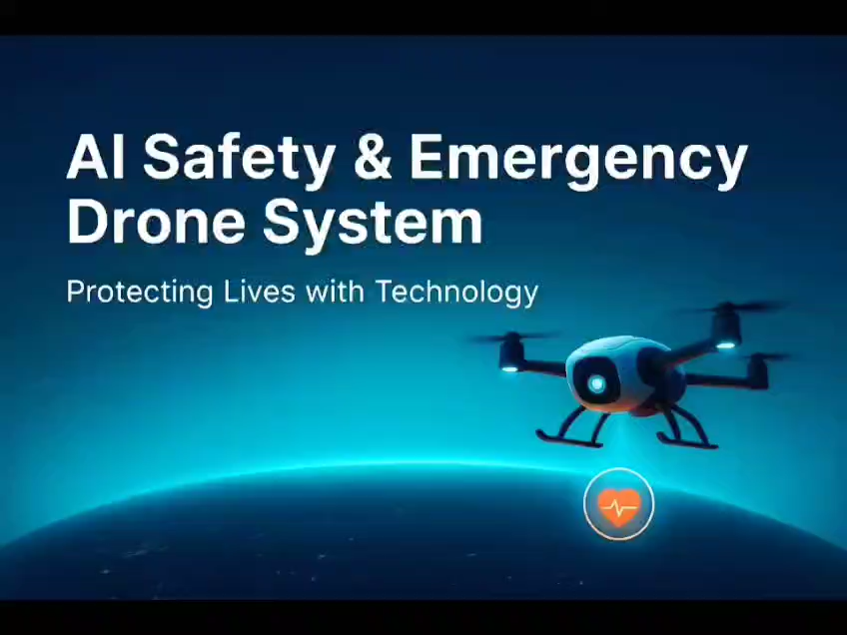
Benefits & Impact In Women’s Safety

Slide 10


Demo: Medical Emergency Response in Action

Slide 11
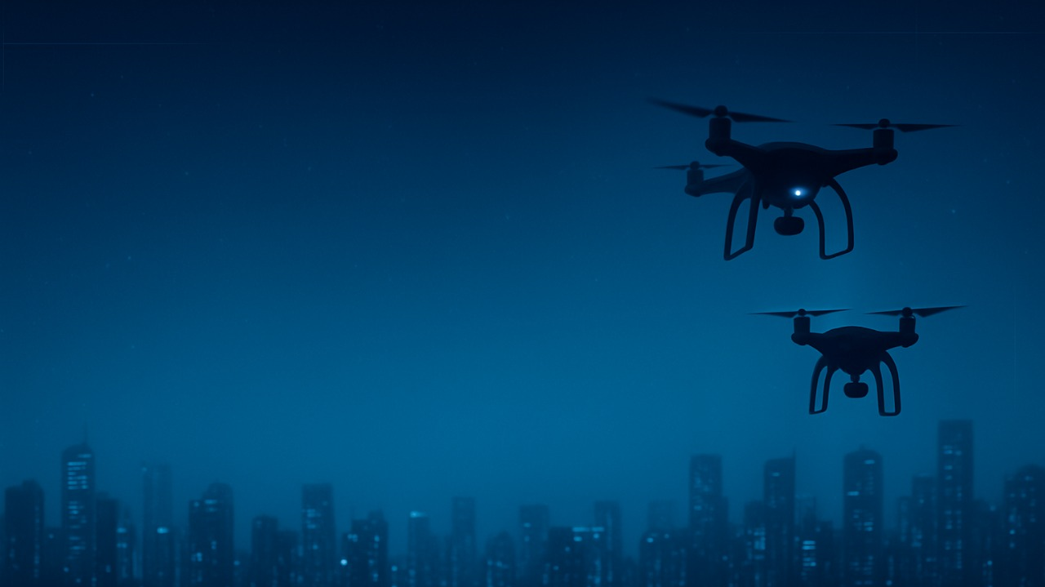
Conclusion
The AI Safety & Emergency Drone System demonstrates how technology can be used as a guardian for society.
Ensures women’s safety through proactive surveillance.
Provides rapid medical response in emergencies.
By bridging innovation and public service, this system has the potential to save lives, reduce crime, and build trust in urban safety
Thank You
Team 7
Members:
Jeevanandham S
Jeevitha M
Naresh B
MAILAM
Engineering College

